Slide 1
DEEP LEARNING PROJECT
GAN-Based Synthetic
Handwritten Digit Generation
Training a Generative Adversarial Network to synthesise novel handwritten digits from the MNIST dataset.
PROJECT TEAM
Amrith Saras · Annabel Marianne Victor · Diya Jothish
102903 / CO701B Deep Learning|Rajagiri School of Engineering & Technology

Slide 2
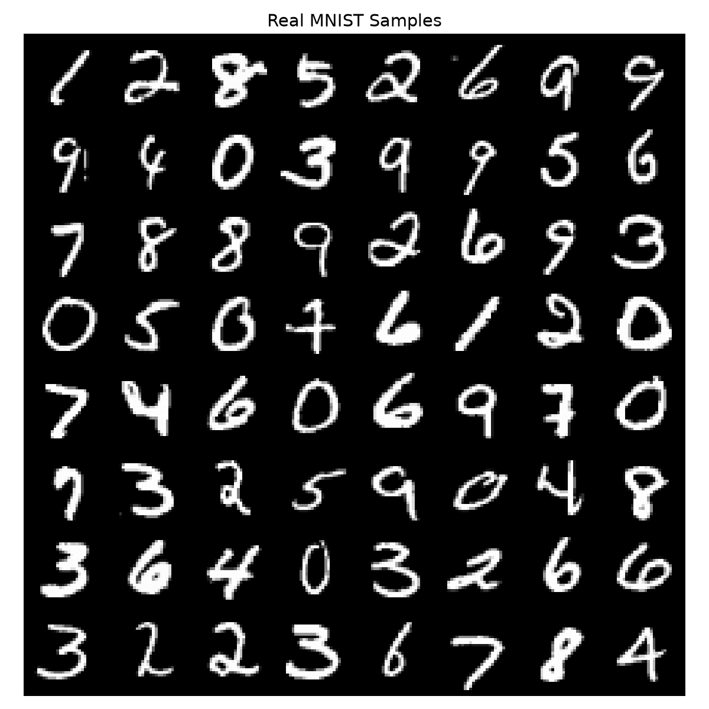
01 · DEFINING THE CHALLENGE
Problem Statement
Handwritten digit recognition is a well studied classification task with mature, high accuracy solutions.
Generating realistic synthetic digits from random noise is a fundamentally different and harder problem: The model must learn the underlying data distribution, not just a decision boundary.
This project implements a Generative Adversarial Network trained on MNIST to learn that distribution and produce novel, visually plausible handwritten digit images.
Real MNIST handwritten digits: the target distribution
GAN-Based Handwritten Digit Generation
2
Notes:
anabel

Slide 3






02 · WHAT WE SET OUT TO DO
Objectives
Understand the GAN framework: The competing objectives of Generator and Discriminator.
Implement a GAN with two competing networks, trained end to end in PyTorch.
Train the model on the full MNIST dataset- all 60,000 greyscale handwritten digit images.
Generate novel synthetic handwritten digits from random Gaussian noise.
Analyse generation quality through training dynamics and visual inspection.
Explore the learned latent space through interpolation between noise vectors.
GAN-Based Handwritten Digit Generation
3
Notes:
anabel

Slide 4
03 · BACKGROUND
The GAN Idea: Two Networks, One Contest
Random Noise z ~ N(0, I) (100 dimensions)
Generator G
Synthetic Image: G(z)
Discriminator D
Real MNIST Image: x
Real or Fake? →Probability score (0, 1)
Training objective: min G max D E[ log D(x) ] + E[ log(1 − D(G(z))) ]
At Nash equilibrium, the Generator matches the real data distribution and D(x) approaches 0.5 for every input, so it can no longer tell real from generated.
GAN-Based Handwritten Digit Generation
4
Notes:
anabel

Slide 5
04 · DATA DESCRIPTION
Dataset: MNIST
Property | Value
Name | MNIST
Source | torchvision.datasets.MNIST (auto-download)
Channels | 1 (greyscale)
Pixel normalisation | [0, 1] → [-1, 1]
60,000
10,000
Training images
Test images
28 × 28
10
Pixel resolution
Digit classes (0–9)
GAN-Based Handwritten Digit Generation
5
Notes:
anabel

Slide 6
04 · DATA
Preprocessing Pipeline
1
2
3
4
Load as Tensors
Normalise
Batch & Shuffle
No Augmentation
Images loaded via torchvision.transforms.ToTensor()
Pixel values rescaled from [0, 1] to [-1, 1] using Normalize([0.5],[0.5]) to match the Generator's Tanh output.
Batch size 128, data reshuffled every epoch for stable gradient estimates.
MNIST is already large and class-balanced, so no augmentation was applied.
GAN-Based Handwritten Digit Generation
6
Notes:
anabel

Slide 7
05 · METHODOLOGY
Methodology: Why a Convolutional GAN
Architecture choice
LeakyReLU (slope 0.2)
Used in the Discriminator hidden layers; the Generator uses ReLU. Avoids dead neurons from plain ReLU.
This implementation uses a Deep Convolutional GAN (DCGAN): Both networks use convolutional layers instead of a stack of fully-connected ones.
Transposed convolutions upsample in the Generator and strided convolutions downsample in the Discriminator, which exploits the spatial structure of images.
Tanh at Generator output
Squashes pixel values to [-1, 1], matching the normalised input images.
Sigmoid at Discriminator output
Produces a clean probability in (0, 1) for the real / fake decision.
BatchNorm in both networks
Applied after each convolutional layer, except the Generator output and Discriminator input.
GAN-Based Handwritten Digit Generation
7
Notes:
anabel

Slide 8
05 · METHODOLOGY
Generator Architecture
Input: Noise vector z (100,)
Linear(100 → 256×7×7) + BN + ReLU
Reshape → feature map (256, 7, 7)
ConvTranspose(256→128) + BN + ReLU
ConvTranspose(128→64) + BN + ReLU
Conv(64→1) + Tanh → (1, 28, 28)
Generator parameters: 1,935,808
GAN-Based Handwritten Digit Generation
8
Notes:
dia

Slide 9
05 · METHODOLOGY
Discriminator Architecture
Input: Image (1, 28, 28)
Conv(1→64) + LeakyReLU(0.2)
Conv(64→128) + BN + LeakyReLU
Conv(128→256) + BN + LeakyReLU
Linear(2304→1) + Sigmoid
Output: P(real) ∈ (0, 1)
Discriminator parameters: 659,457
GAN-Based Handwritten Digit Generation
9
Notes:
dia

Slide 10
06 · IMPLEMENTATION
Implementation & Training Setup
Component | Detail
Framework | PyTorch 2.11.0+cu128
Hardware | NVIDIA GeForce RTX 3050 Laptop GPU
Optimiser | Adam (lr = 0.0002, betas 0.5/0.999)
Loss function | Binary Cross-Entropy (BCELoss)
Epochs | 50
Batch size | 128
Latent dimension | 100
Training design choices
Independent Adam optimisers for G and D, so each network updates from its own gradients.
fake_imgs.detach() is used when computing the Discriminator's loss, which stops gradients flowing back into G during D's update step.
A fixed 64-sample noise vector was reused every epoch, so generated samples could be compared side by side as training progressed.
Sample grids saved every 5 epochs- random seed fixed at 42 for reproducibility.
GAN-Based Handwritten Digit Generation
10
Notes:
dia

Slide 11
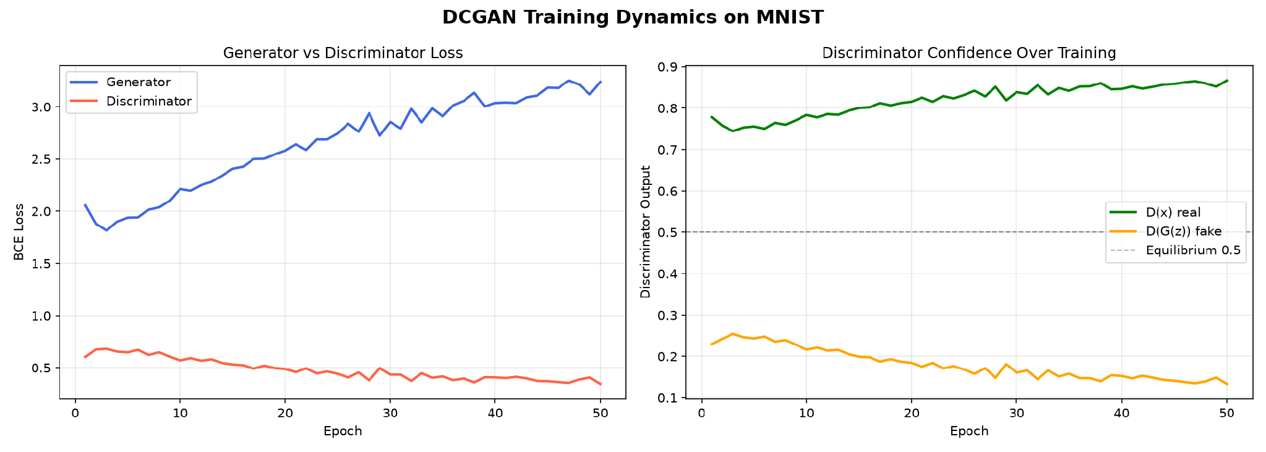
07 · RESULTS
Training Dynamics
Over 50 epochs the discriminator held a consistent edge: Its confidence on real images rose from about 0.78 toward 0.87, while its confidence on generated images fell from about 0.23 toward 0.13.
This pattern is common when training a DCGAN on MNIST, and it did not stop the generator from producing recognisable digits, as the following slides show.
GAN-Based Handwritten Digit Generation
11

Slide 12
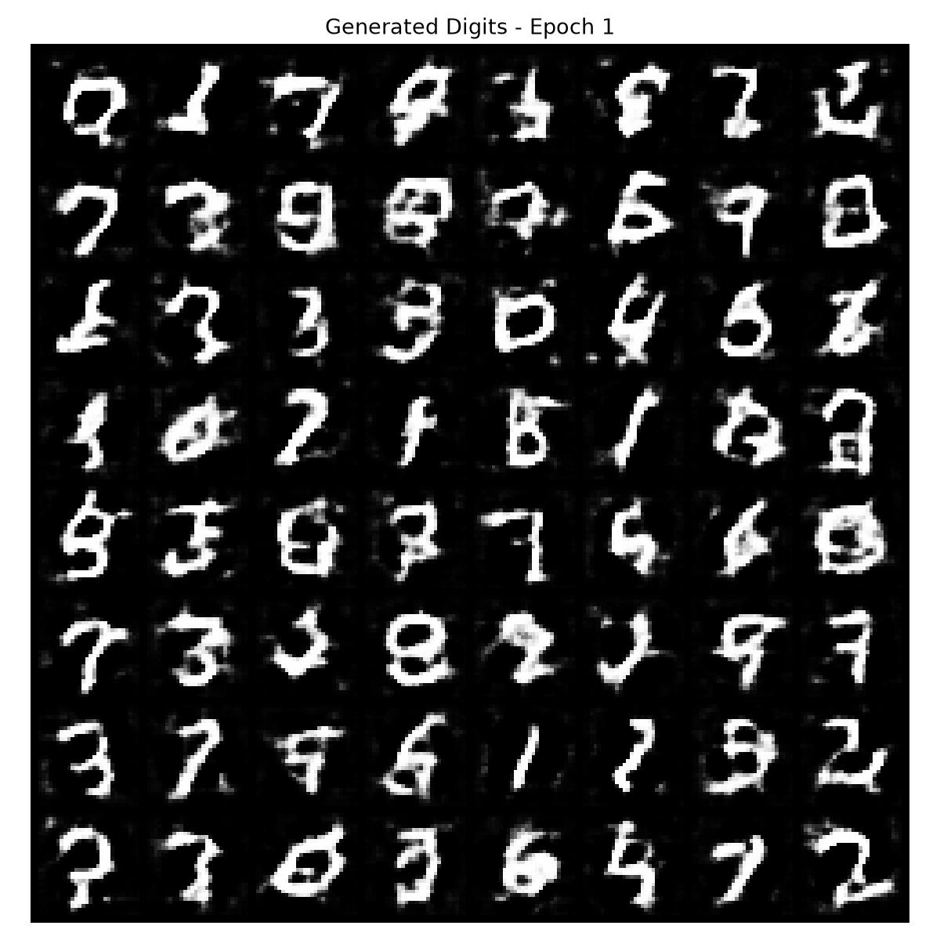
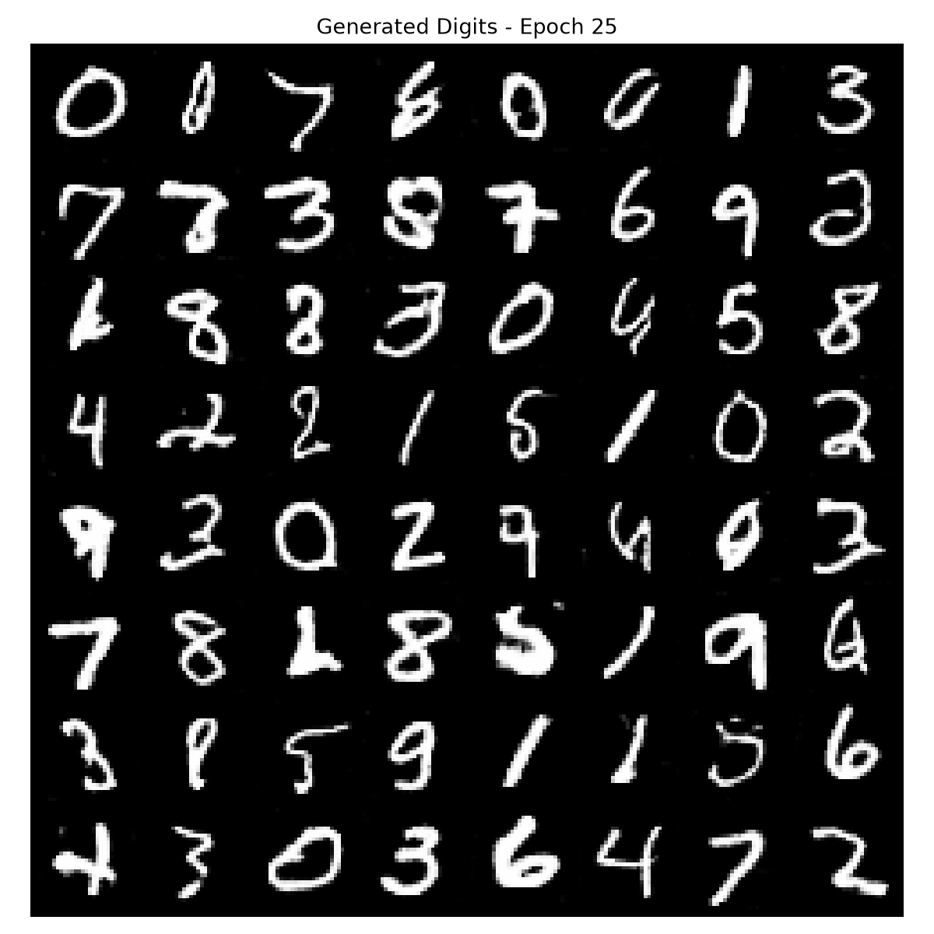
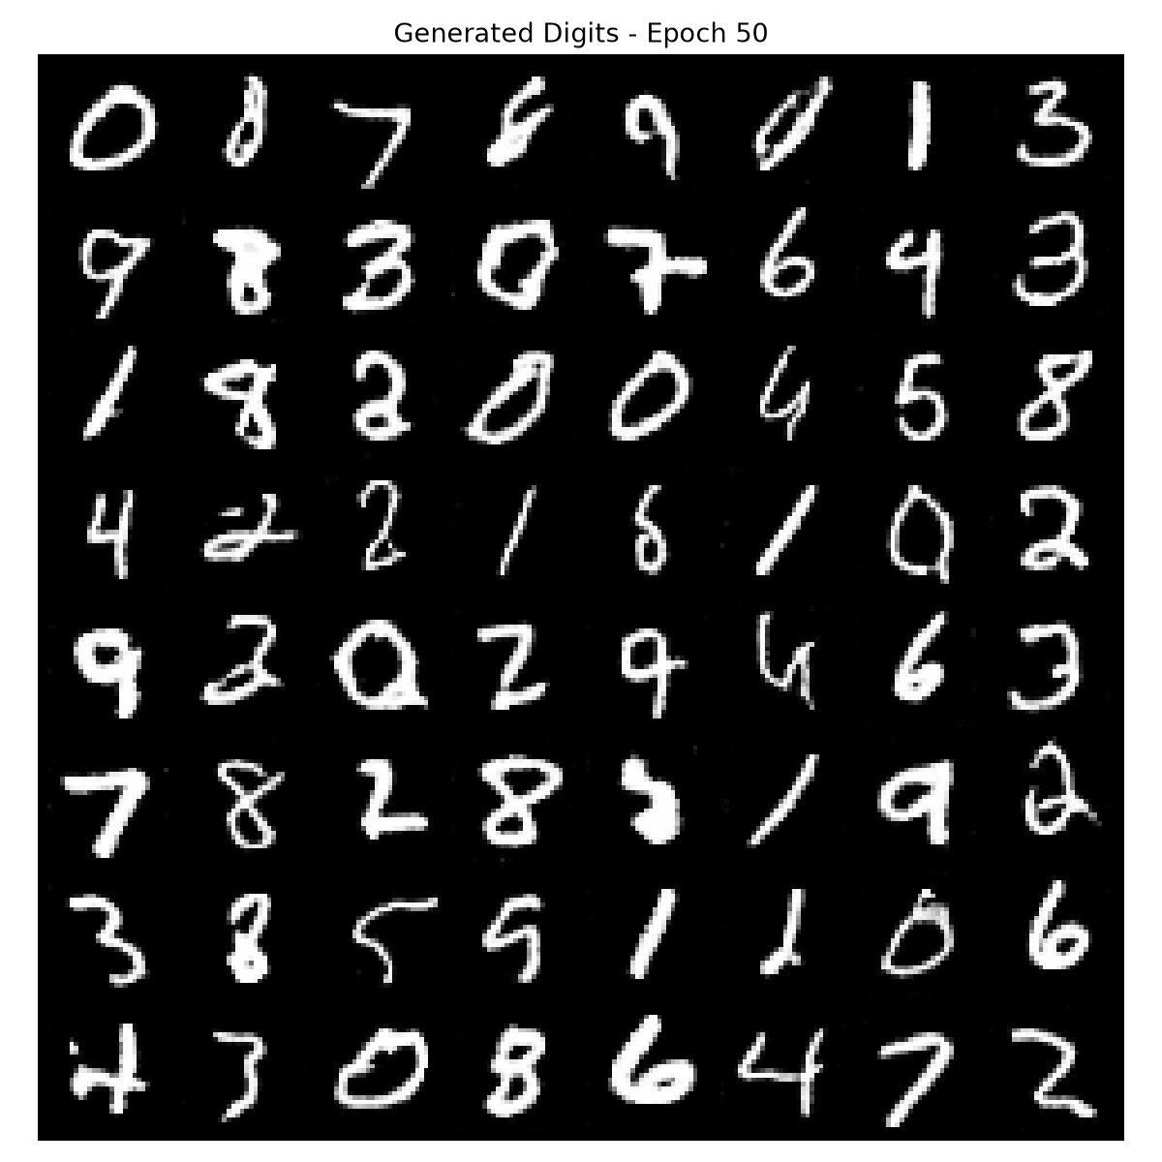
07 · RESULTS
Generation Quality Across Training
Epoch 1
Epoch 25
Epoch 50
Thick, blobby, often malformed
Rough digit-like shapes emerging
Recognisable digits across classes
GAN-Based Handwritten Digit Generation
12

Slide 13
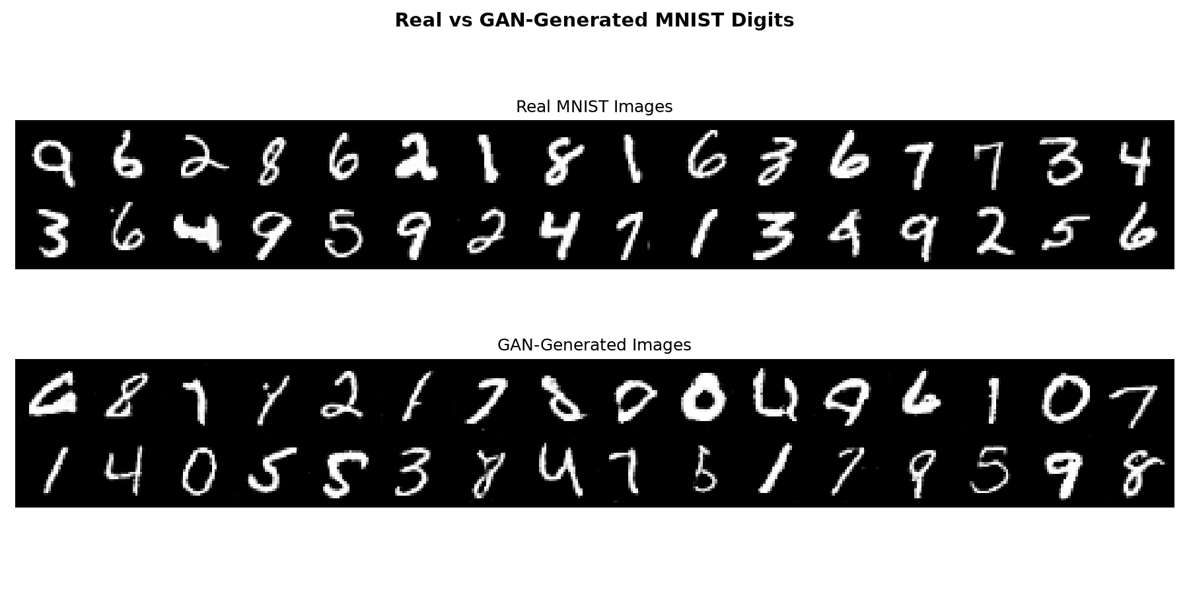
07 · RESULTS
Real vs Generated Digits
Generated digits are visually plausible across most classes, with occasional uneven strokes. The Discriminator still separates real from generated with high confidence at the end of training.
GAN-Based Handwritten Digit Generation
13

Slide 14
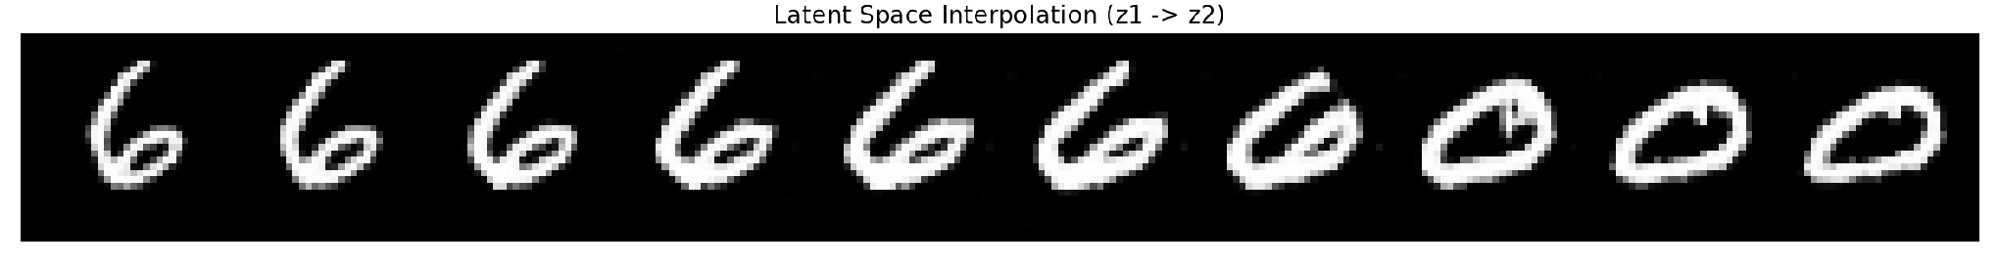
07 · RESULTS
Latent Space Interpolation
10 interpolation steps z₁ → z₂
Interpolating between two random noise vectors z₁ and z₂ produces a smooth, continuous sequence of plausible digit shapes rather than an abrupt jump.
This is evidence that the Generator learned a structured latent space, instead of simply memorising individual training examples.
GAN-Based Handwritten Digit Generation
14

Slide 15
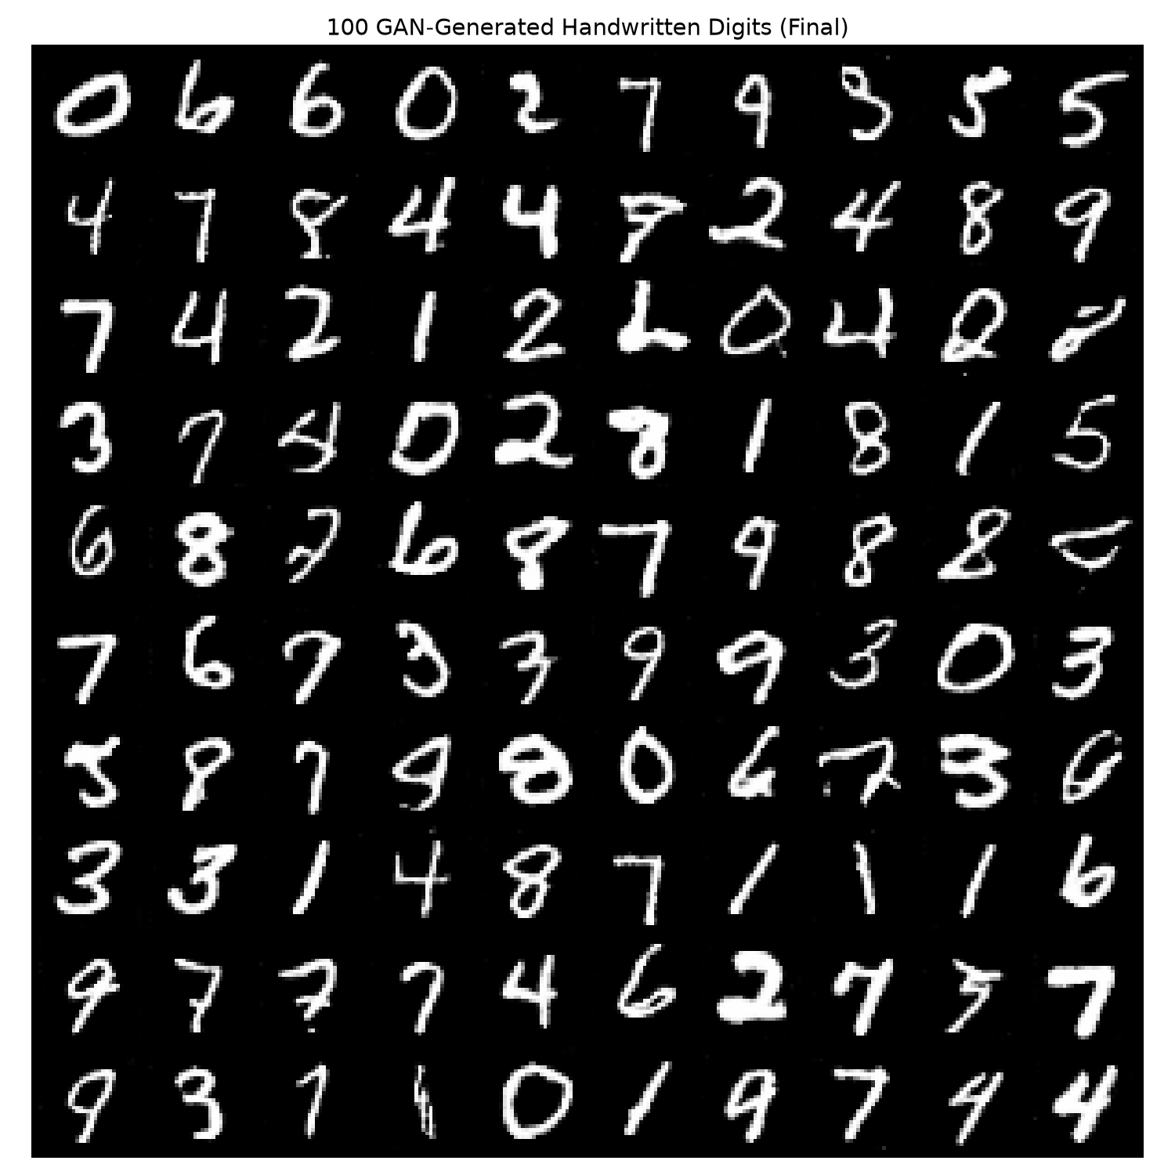
07 · RESULTS
100 Digits Generated From Noise
A representative spread across all ten digit classes (0–9), generated purely from random noise.
Some classes appear more often than others, a mild imbalance rather than full mode collapse.
A few ambiguous shapes remain, with occasional uneven stroke thickness.
GAN-Based Handwritten Digit Generation
15

Slide 16
08 · EVALUATION
Quantitative Evaluation
Metric | Value
Accuracy | 0.669
Precision | 0.715
Recall | 0.562
F1 score | 0.629
Fakes that fooled D | 22.4%
Evaluated on | 2,000 real + 2,000 fake, eval mode
How to read these numbers
The Discriminator is a binary classifier, so these metrics apply to it, not to the Generator.
The scoring is inverted: 100% accuracy would mean the Generator is failing, and 50% would mean it is perfect.
At 66.9%, roughly one generated digit in five slips past the 0.5 threshold undetected.
The Generator has no ground-truth label, so it is judged by FID and mode coverage instead.
GAN-Based Handwritten Digit Generation
1
Notes:
dia

Slide 17
08 · ANALYSIS
Analysis & Interpretation
What Worked
Limitations
Digit-like structure emerged by epoch 10–15 and became clearly recognisable by epoch 50, across multiple classes.
Latent space interpolation confirmed a smooth, continuous internal representation rather than memorisation.
The adversarial setup trained end to end without fully collapsing, and the generator kept improving throughout.
No quantitative FID (Fréchet Inception Distance) score was computed, due to compute constraints.
The discriminator kept a persistent edge rather than settling near the theoretical 0.5 equilibrium.
Minor artefacts remain in stroke thickness compared with real MNIST samples.
No class conditioning: the model cannot yet be asked to generate one specific digit.
GAN-Based Handwritten Digit Generation
16

Slide 18
09 · CONCLUSION
Conclusion
A Deep Convolutional GAN (DCGAN) was implemented and trained on MNIST for 50 epochs, learning to generate visually plausible handwritten digits from 100-dimensional Gaussian noise across all ten digit classes. Latent space interpolation confirmed the model learned a smooth, structured internal representation rather than memorising the training set. The project validates the core GAN principle: two competing networks, trained together, can produce a working generative model.
50
1.94M
10 / 10
Epochs trained
Generator parameters
Digit classes represented
GAN-Based Handwritten Digit Generation
17
Notes:
dia

Slide 19
10 · WHAT'S NEXT
Future Scope
1
2
3
4
5
Conditional GAN
Wasserstein GAN
FID Score
Label Smoothing
Data Augmentation
Condition on the digit class label to generate a specific digit on demand.
Use the Wasserstein distance for more stable training and convergence.
Compute Fréchet Inception Distance for quantitative quality benchmarking.
Smooth real labels or slow the Discriminator to rebalance training.
Use generated digits to augment classifiers trained on imbalanced data.
GAN-Based Handwritten Digit Generation
18
Notes:
dia

Slide 20

11 · TEAM
Individual Contributions
Amrith Saras
Diya Jothish
Annabel Marianne Victor
Designed and implemented the Generator architecture and full training loop.
Implemented the latent space interpolation experiment.
Set up the GPU training environment (CUDA PyTorch).
Verified model saving and loading.
Designed and implemented the Discriminator architecture and weight initialisation.
Coded all visualisation functions
Handled MNIST data loading, normalisation and DataLoader setup.
Analysed training dynamics and documented the results.
Verified generated image quality across epochs.
GAN-Based Handwritten Digit Generation
19
Notes:
dia

Slide 21
Thank You
Amrith Saras · Annabel Marianne Victor · Diya Jothish
A15 · 102903 / CO701B Deep Learning · Rajagiri School of Engineering & Technology

